Slide 1
State Policies Impacting CTE
2024 Year in Review

Slide 2
State Policy Context
Collaboration between Advance CTE and ACTE
Tracking CTE-related policies throughout the year
Sortable, longitudinal state policy tracker via PowerBI
Report and presentations on yearly trends and findings
Notes:
Here, also talk about its importance for state policy.

Slide 3
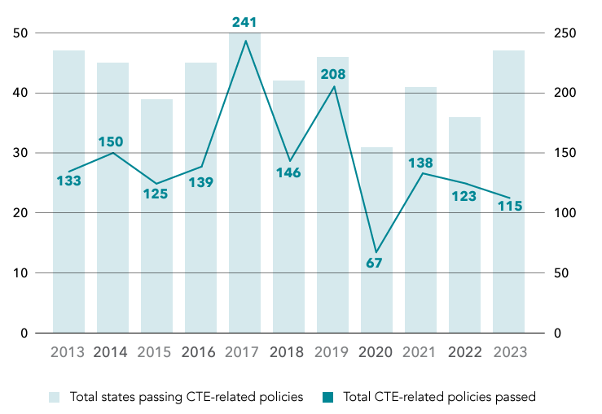
Number of States Passing CTE-related Policies and the Number of CTE-related Policies Passed (2013 – 2023)

Slide 4
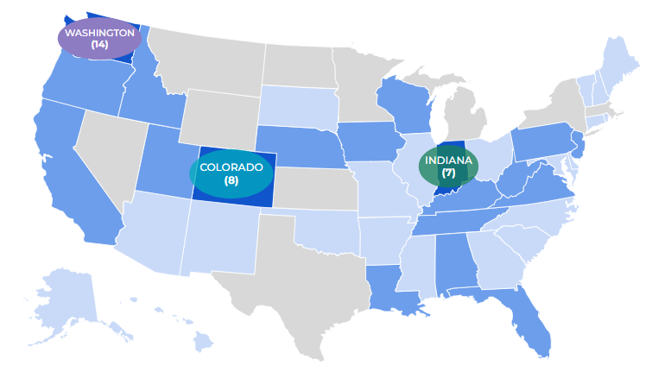
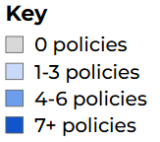
Year in Review – 2024 CTE Policies by State
152 policies across 40 states
7 fewer states; 37 more policy actions in 2024 compared to 2023
Systems Affected
Secondary: 90
Adult & Workforce: 65
Postsecondary: 58

Slide 5
Top Categories
Top Categories - 2023
Top Categories - 2024
- Industry partnerships and work-based learning (48)
- Funding (63) ↑
- Industry partnerships and work-based learning (46) ↓
- Data, reporting, and/or accountability (37)
- Access and Supports (37) *
- Funding (32)
- Data, reporting, and/or accountability (32) ↓
- Governance (24)
- Industry-recognized credentials (27) *
- Graduation requirements (18)

Slide 6
Funding
63 policies | 26 states
IDAHO
$20 mil. to the Career Ready Students Program Fund.
(HB 763)
WEST VIRGINIA
Up to $300,000 to career centers for computer science and cybersecurity instruction for adult learners.
(HB 4986)
WISCONSIN
Allocating a maximum of $20 mil. to assist technical colleges in expanding the state’s oral healthcare workforce.
(SB 702)

Slide 7
Industry Partnerships/Work-based Learning
46 policies | 29 states
FLORIDA
Supporting health centers to offset the costs of training future healthcare practitioners through the TEACH funding program
(SB 7016)
COLORADO
Aligning the state’s high school CTE system with its registered apprenticeship system for emerging industries
(HB 1439)
SOUTH CAROLINA
Increasing the tax credit that employers may receive when hiring apprentices through the U.S DOL Registered Apprenticeship Program
(SB 557)

Slide 8
Access and Supports
37 policies | 21 states
IDAHO
Increasing postsecondary access to economically disadvantaged learners
(HB 500)
ILLINOIS
Including a $10.2 million increase for CTE programs to begin implementation of a new equity-based funding formula.
(IL FY25 Budget)
NEW MEXICO
Establishing a Workforce Pilot Program to offer stipends to residents enrolled in a workforce training pathway
(HB 303)

Slide 9
Data, Reporting, and/or Accountability
32 policies | 21 states
CONNECTICUT
Establishing a task force to study workers’ compensation coverage for ag. science learners
(SB 407)
GEORGIA
Requiring the State Workforce Development Board to publish an annual high-demand career list
(HB 982)
SOUTH DAKOTA
Requiring that the number of individuals passing a certification exam in a public technical college be reported
(HB 1058)

Slide 10
Industry-recognized Credentials
27 policies | 20 states
ARIZONA
Allowing those who completed an approved apprenticeship program to file for a certificate of completion
(HB 2090)
KENTUCKY
Allowing hours of work experience to be partially substituted by an IRC in electrical technology
(HB 444)
NEBRASKA
Issuing licenses/certifications based on education or work experience in another state or the military
(LB 16)

Slide 11
Expanding Apprenticeship Opportunities
Big push for apprenticeships:
Less interest in college
Apprenticeship enrollment up
Businesses benefit
Bipartisan approval
Strong federal support and investment:
Office of Apprenticeship
Biden: $244M investment
Trump: Expand apprenticeships

Slide 12
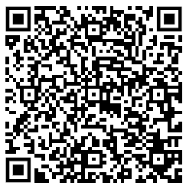
Reports and Tracker
State Policies Impacting CTE: Years in Review
Longitudinal State Policy Tracker

Slide 13
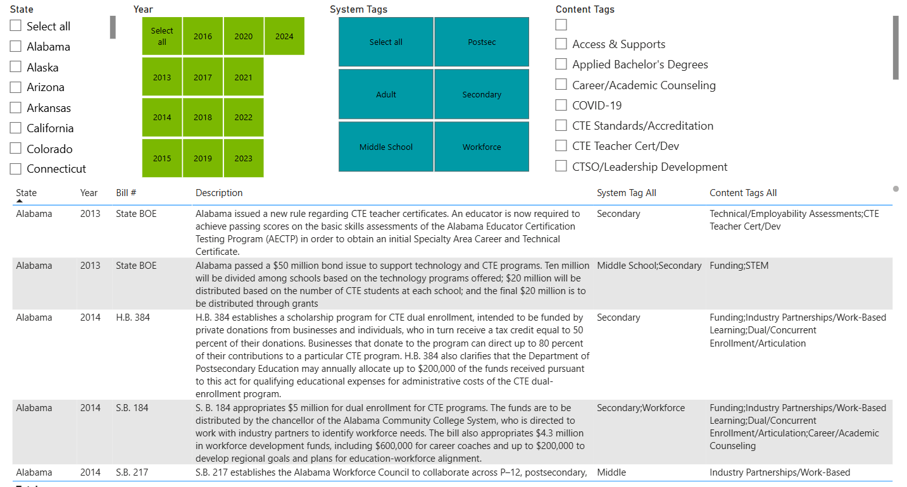

Slide 14
Questions?
Jesus Galvan, Research and Policy Coordinator @ ACTE
jgalvan@acteonline.org

