Slide 1

State Policies Impacting CTE
2025 Year in Review
Photo by Allison Shelley/Complete College Photo Library

Slide 2
Overview
13th annual collaboration between ACTE and Advance CTE
Tracking policies throughout the year, policies validated by state CTE directors
Report and presentations on yearly trends and findings
Sortable, longitudinal state policy tracker, houses every policy tracked since 2013

Slide 3
State Policy Context
Better understand national and state trends
Review policies and models that you can implement in your area
Advocate for quality policy in your own state.

Slide 4
CTE Policy Tags
FUNDING
WORK-BASED LEARNING
ACCESS/SUPPORTS
DATA, REPORTING, AND ACCOUNTABILITY
Review policies and models that you could implement in your local area
INDUSTRY-RECOGNIZED CREDENTIALS
DUAL/CONCURRENT ENROLLMENT
CAREER/ACADEMIC COUNSELING
CTE TEACHER DEVELOPMENT
GRADUATION REQUIREMENTS
CTE STANDARDS
CTSOs
CREDIT FOR PRIOR LEARNING

Slide 5
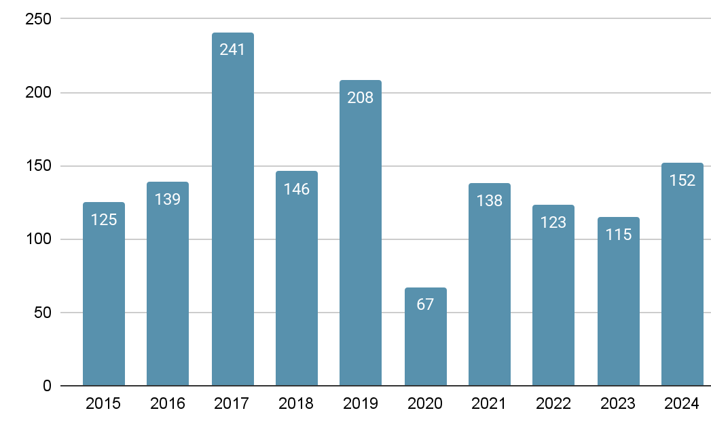
Number of Enacted CTE Policies, 2015-24

Slide 6
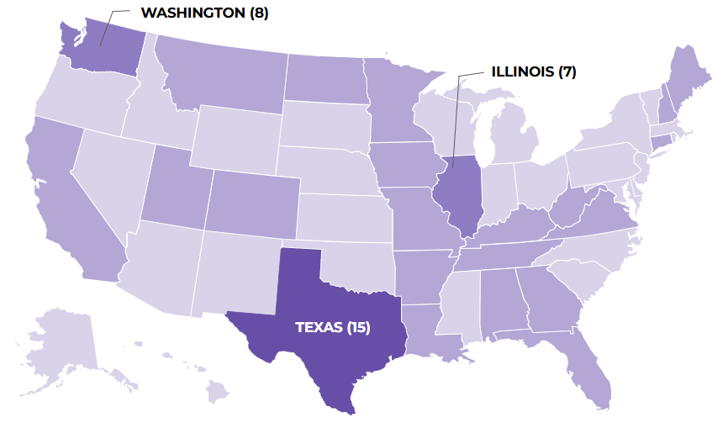
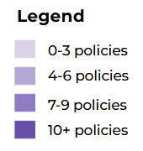
High-Level Findings for 2025
172 ENACTED POLICIES
across
49 STATES

Slide 7



Top Systems Affected
Secondary (116)
Postsecondary (88)
Adult Education/Workforce Development (79)

Slide 8
Top Policy Categories
2024
1
Funding (63)
2
Industry Partnerships/Work-Based Learning (46)
3
Access and Supports (37)
4
Data, Reporting, and/or Accountability (32)
5
Industry-Recognized Credentials (27)

Slide 9
Top Policy Categories
2024
2025
1
Funding (63)
1
Funding (67); Industry Partnerships/ Work-Based Learning (67)
2
Industry Partnerships/Work-Based Learning (46)
2
Data, Reporting, and/or Accountability (63)
3
Access and Supports (32)
3
Access and Supports (54)
4
Data, Reporting, and/or Accountability (32)
4
Industry-Recognized Credentials (47)
5
Industry-Recognized Credentials (27)
5
Dual/Concurrent Enrollment, Articulation, and Early College (33)

Slide 10
Spotlight: Academic Credit for CTE
Policies that integrate academic and technical coursework
Allow learners to gain both foundational and occupational knowledge through CTE programs aligned with core subjects
UTAH (HB 447) allows high school students to substitute “fine arts” credit for the purposes of graduation with woodworking, metalworking/welding, traditional handcrafts, architectural trades such as carpentry, and digital design/animation courses.

Slide 11
Funding
67 policies | 34 states
MASSACHUSETTS
$100M to expand seats in CTE programs across the state
(Supplemental Budget)
MISSOURI
Establishes the Career-Tech Certificate Program and Fund, connecting learners with short-term training programs
(SB 150)
WASHINGTON
Awards grant funding for a pilot program aimed at increasing CTE dual credit participation and credential attainment
(HB 1273)

Slide 12
Industry Partnerships/Work-based Learning
67 policies | 34 states
COLORADO
Establishes a 3-year WBL Consortium Pilot program to expand access to work-based learning in postsecondary courses
(HB 1186)
LOUISIANA
Creates a WBL Tax Credit to incentivize employers to hire and train apprentices, interns, and youth workers
(HB 533)
MONTANA
Establishes the 406 JOBS Initiative, connecting workforce development programs between agencies and partners
(EO 5)

Slide 13
Data, Reporting, and/or Accountability
63 policies | 34 states
GEORGIA
Requires the State Workforce Development Board to develop a data-driven methodology for its High-Demand Career List
(HB 192)
INDIANA
Implements various data and reporting requirements, including developing a market-driven stackable credentials framework
(SB 448)
LOUISIANA
Directs the Workforce Investment Council to conduct a ROI analysis of high school industry-recognized credentials
(HB 373)

Slide 14
Access and Supports
54 policies | 27 states
KENTUCKY
Establishes the Team Kentucky Office of Reentry Services, connecting justice-involved individuals with training programs
(EO 253)
NEW YORK
Allows adults aged 25-55 to pursue associate degrees in high-demand fields for free
(FY26 Budget)
OKLAHOMA
Creates the Oklahoma National Guard CareerTech Assistance Program, providing tuition assistance to Guard members who enroll in technology center schools
(HB 303)

Slide 15
Industry-recognized Credentials
47 policies | 30 states
MAINE
Creates the Credentialed Workforce Program to support the state’s workforce through industry-aligned credentials
(LD 1653)
TEXAS
Directs the Texas Workforce Commission to establish a workforce development program in advanced nuclear energy
(SB 1535)
UTAH
Establishes the First Credential Program, encouraging high school students to earn an industry-recognized credential
(HB 260)

Slide 16
Dual/Concurrent Enrollment
33 policies | 25 states
IDAHO
Allows community colleges to enroll homeschool learners in dual credit courses
(HB 175)
OREGON
Requires the Higher Education Coordinating Commission to develop dual credit program standards for agriculture, forestry, and natural resources programs
(SB 784)
WEST VIRGINIA
Creates a statewide guaranteed transfer program so learners can transfer credits between high schools, CTE centers, community colleges, and four-year schools
(HB 3024)

Slide 17
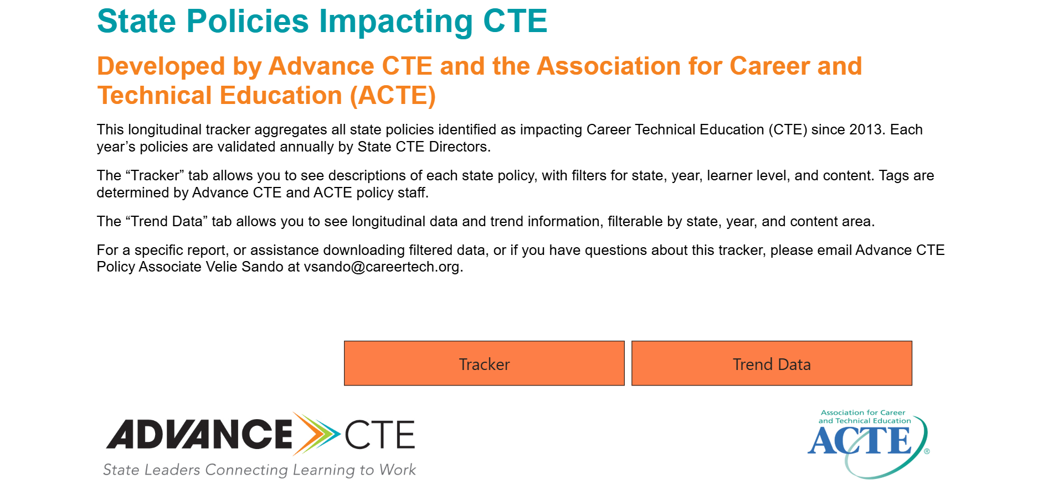
Longitudinal State Policy Tracker

Slide 18
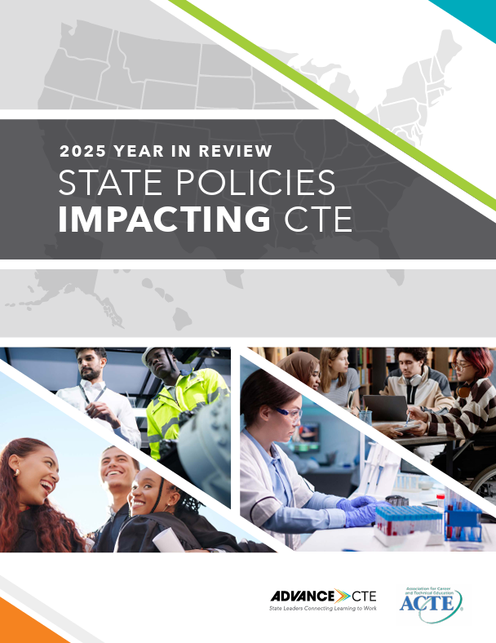
Thank you!
jgalvan@acteonline.org

