Slide 1
Workforce Pell:
What Employers Should Know
Webinar
May 19, 2026
Jeran Culina

Slide 2

In July 2025, Congress expanded the Pell Grant program to cover shorter-term programs.
Billions of dollars of new funding were made available through H.R. 1

Slide 3

Who is eligible to receive the new funds?

Slide 4

Organizations must be accredited and eligible under the Higher Education Act to receive federal student financial aid.*
*Some subcontractors may not need to be HEA-eligible.

Slide 5

Students must meet Pell eligibility requirements for income, etc.

Slide 6

Some people who have already earned bachelor’s degrees are eligible for Workforce Pell.

Slide 7

For a specific program to be eligible, it must:
Be between 8-14 weeks and 150-599 clock hours in length*
Have been up and running for at least 1 year
Provide postsecondary skills training that leads to a recognized credential
Additional note: Noncredit programs can be eligible if they are stackable to a credit-bearing pathway
*However, in certain cases related to Registered Apprenticeship programs, this time period does not have to be continuous.

Slide 8

Also important to note:
States are at the center of Workforce Pell

Slide 9
Oversight is left to the states
This means states will have different processes of approval
States will need to:
  Determine which programs qualify
  Monitor program outcomes
  Set quality guardrails

Slide 10
Program Eligibility
The governor, in consultation with the state’s workforce board, must provide a process to:
  Create alignment with high-skill, high-wage (def. Perkins), or in-demand industry sectors (def. WIOA).
  Meet employer hiring requirements.
  Lead to a recognized, stackable, & portable credential across employers
  Must count for academic credit toward a certificate or degree

Slide 11
Type of programs that might be eligible
Clinical medical assistant
Phlebotomy technician
EMT
Welding
Commercial driver’s license (short- and long-haul trucking)

Slide 12

Oh and there is more…

Slide 13
Accountability metrics
Completion
  Greater than 70% completion rate
Placement:
  Greater than 70% “verified” job placement rate in occupation
Value Added Earnings
  New metric for ROI on programs
  Defined by whether program graduates earn more than the cost of the program

Slide 14

Workforce Pell funding becomes available* on July 1, 2026 for the 2026-27 academic year
*For programs that have been up and running for at least 1 year and have the required outcome data.

Slide 15
Notes for roll out…
Workforce Pell is only one tool to meet workforce needs
July 1 is the deadline for implementation
  However it is the starting point for better education and employer alignment

Slide 16
Opportunities for complementary advocacy
Wrap around supports that meet the needs of workers
Industry partnerships to truly engage employers
Data collection and modernization: CTA

Slide 17
Challenges states will face
Data infrastructure for outcomes reporting
Consistent definitions
Ability to work cross agency and with industry

Slide 18
What's the current status?

Slide 19

The federal government has just released final rules for the Workforce Pell program

Slide 20
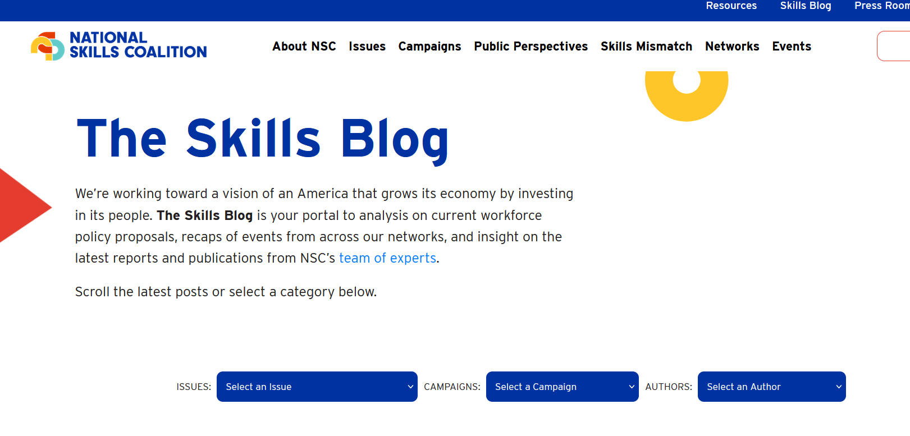
What do the federal regulations say?
See our quick analysis on LinkedIn: https://www.linkedin.com/posts/caroline-treschitta_congratulations-to-the-us-department-of-share-7462226130142490624-ZC7j
Check our Skills Blog for a more detailed analysis soon: https://nationalskillscoalition.org/skills-blog/

Slide 21
Three changes from draft
Students who continue their education will not be counted toward the value added earning metric.
On data modernization support
  "The Department commits to continue collaboration with stakeholders, monitor implementation closely, and prepare additional guidance or resources."
25% remains for the allowable percentage of ineligible partners except for RTI in apprenticeships (49%)

Slide 22
Employer engagement comments…
The Department may provide guidance as needed; however, paragraph (a)(2) of this section requires Governors to consult with the State board to certify that the program “[m]eets the hiring requirements of potential employers . . .”. We believe that there is a sufficient requirement already in the regulation that establishes employer input and each individual State and the outlying area will have unique processes for engaging with employers. The Department does not seek to infringe on the autonomy of Governors by prescribing strict or confusing guidance at the Federal level.

Slide 23

What should industry do next?

Slide 24
Role of employers in Workforce Pell
Validate the value of credentials tied to specific occupations
  This ensures programs stay aligned to real workforce demand
  Also will ensure programs remain eligible under Workforce Pell
Hiring program completers
  Strong employment outcomes are essential
    Reminder: Benchmark in Workforce Pell is 70% job placement
    May want to consider guaranteed interviews
Notes:
This means validating the skills, competencies, and credentials needed to meet hiring requirements.

Slide 25
Steps you can take now:
  Over the summer check in with your local community college to see where they are in determining what programs currently qualify
    This also means beginning discussions on what future programs might be able to qualify
  Connect with your state labor and Governor’s office to see how they will seek employer input on whether programs meet local hiring needs
  Understand where workforce stakeholders could use support and advocacy from employers to state legislators to make the roll out easier

Slide 26
What else should employers know?

Slide 27
A note on Pell shortfall
Projected funding shortfall starting 2027 fiscal year (so right now!)
Of that shortfall Workforce Pell is:
  projected to cost $2/3B over 10 years
    Equals 0.38% of total Pell funding
Our ask?
  Lawmakers should pass stable and mandatory funding
Notes:
, not limit eligibility or decrease grant amounts

Slide 28

Time for your questions!

Slide 29
Stay in touch!
  Jeran Culina
  Senior Manager, NSC’s Business Leaders United
  jeranc@businessleadersunited.org
  Cell: 616-283-0152

Slide 30

businessleadersunited.org

