Slide 1
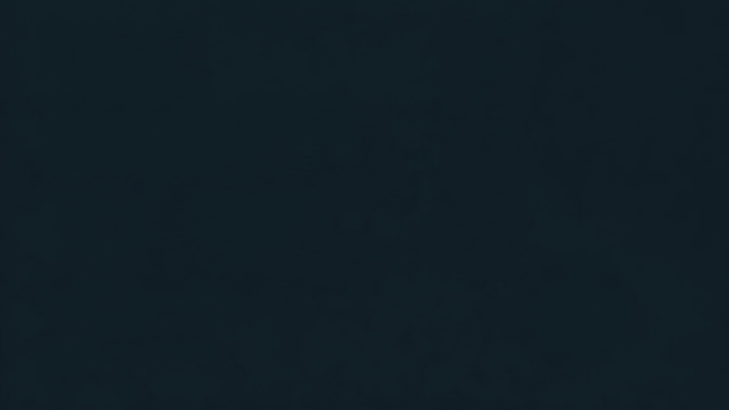



FROM AWARENESS TO ACTION
Strategies for Mobilizing Members
Around Workforce and Education Priorities
Cory Blaylock
// September 2026

Slide 2

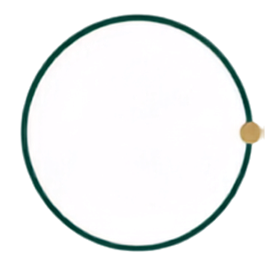



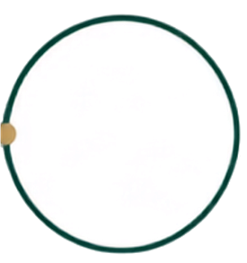


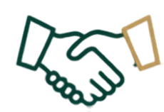


FROM AWARENESS TO ACTION
02 / Section
I’VE BEEN A PART OF THIS CHALLENGE ON EVERY SIDE.
Classroom
Employer
Association
Workforce Board
People Operations

Slide 3












FROM AWARENESS TO ACTION
03 / Approach
Where does participation stall?
No response
Interest without commitment
Commitment without follow-through
The same people participate
Tell us in the chat.

Slide 4











FROM AWARENESS TO ACTION
04 / START WITH THE PERSON
Start with the person taking the next step.
Learner
Educator
Employer
Intermediary
Can I see an opportunity?
Can this work for
my students?
What will
participation require?
How can I remove obstacles?

Slide 5








FROM AWARENESS TO ACTION
05 / CASE STUDY
Make the opportunity specific.
Skill
Learning experience
Opportunity

Slide 6






FROM AWARENESS TO ACTION
06 / From Awareness to Action
What Can We Build Once, Together?
Shared tools. Clear guidance. A supported first step.
ASSOCIATION
PARTICIPATING MEMBERS
Provides tools, guidance, connections, and a clear starting point.
Take the first step with the support and clarity they need to participate.

Slide 7



FROM AWARENESS TO ACTION
07 / GIVE PEOPLE A ROLE
GIVE PEOPLE A ROLE
IN THE CONVERSATION.
EXPERIENCE.
EVIDENCE.
ASK.

Slide 8





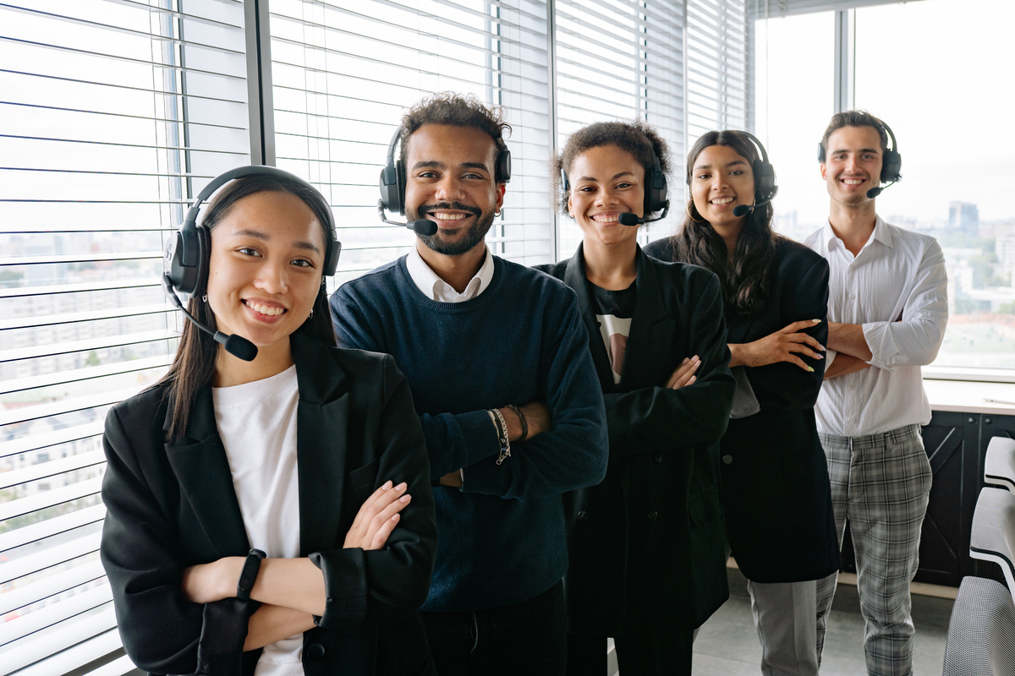

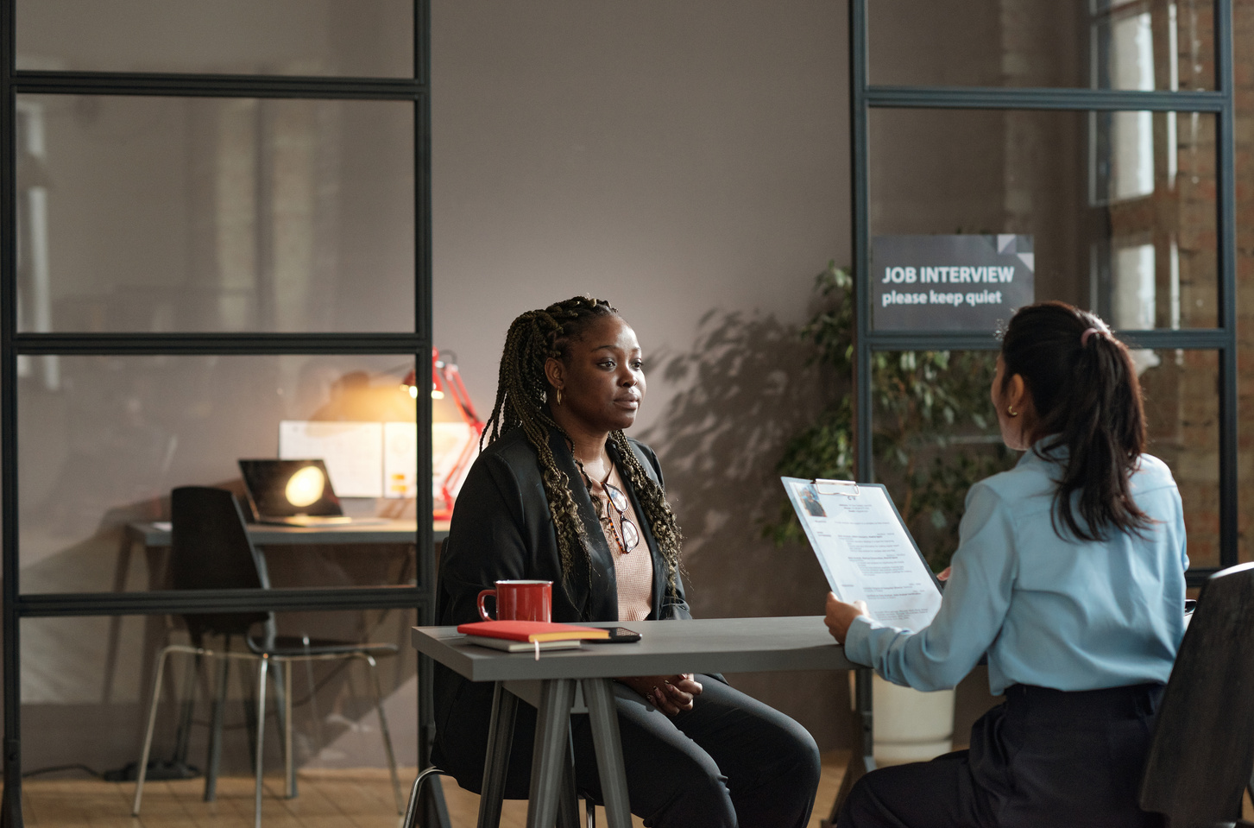



FROM AWARENESS TO ACTION
08 / VOICES
MAKE THE COMMITMENT MANAGEABLE.
TIME
OWNER
SUPPORT
NEXT STEP
MAKE IT EASIER FOR PEOPLE TO TAKE THE NEXT STEP.

Slide 9

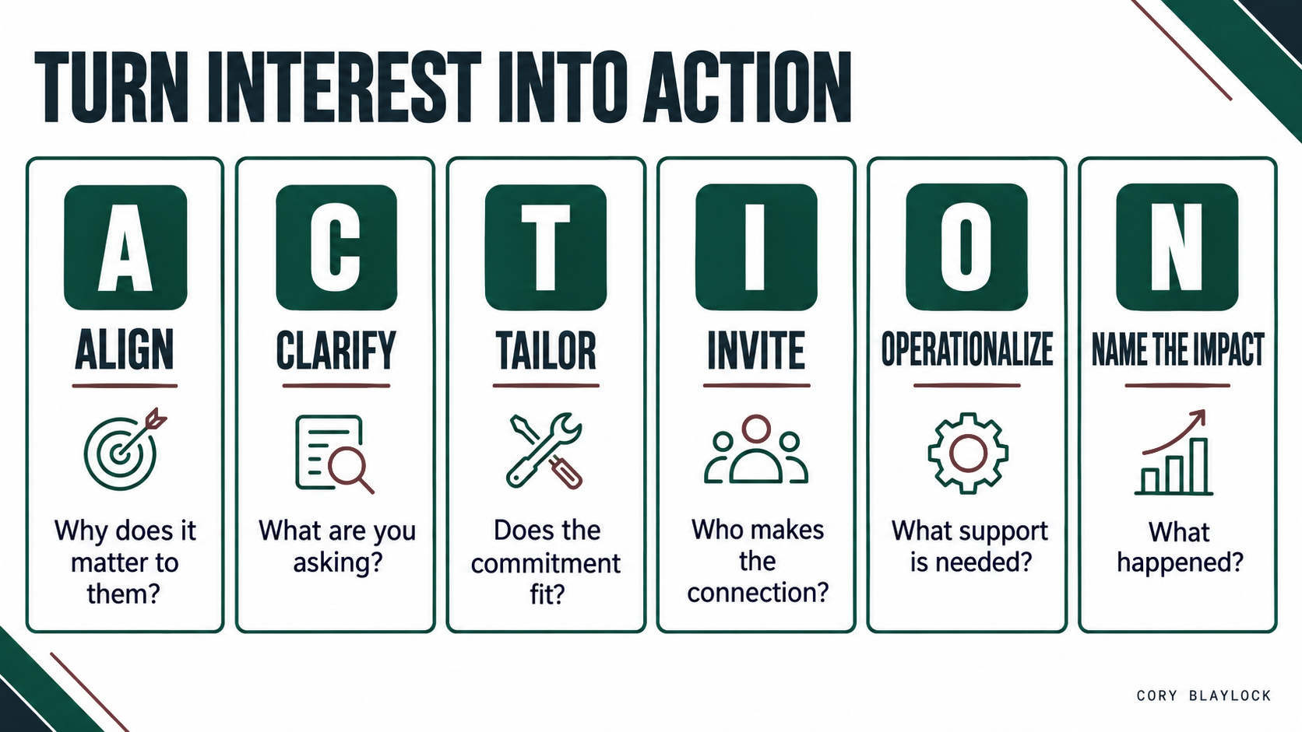
FROM AWARENESS TO ACTION
09 / TURN INTEREST INTO ACTION
TURN INTEREST INTO ACTION.

Slide 10
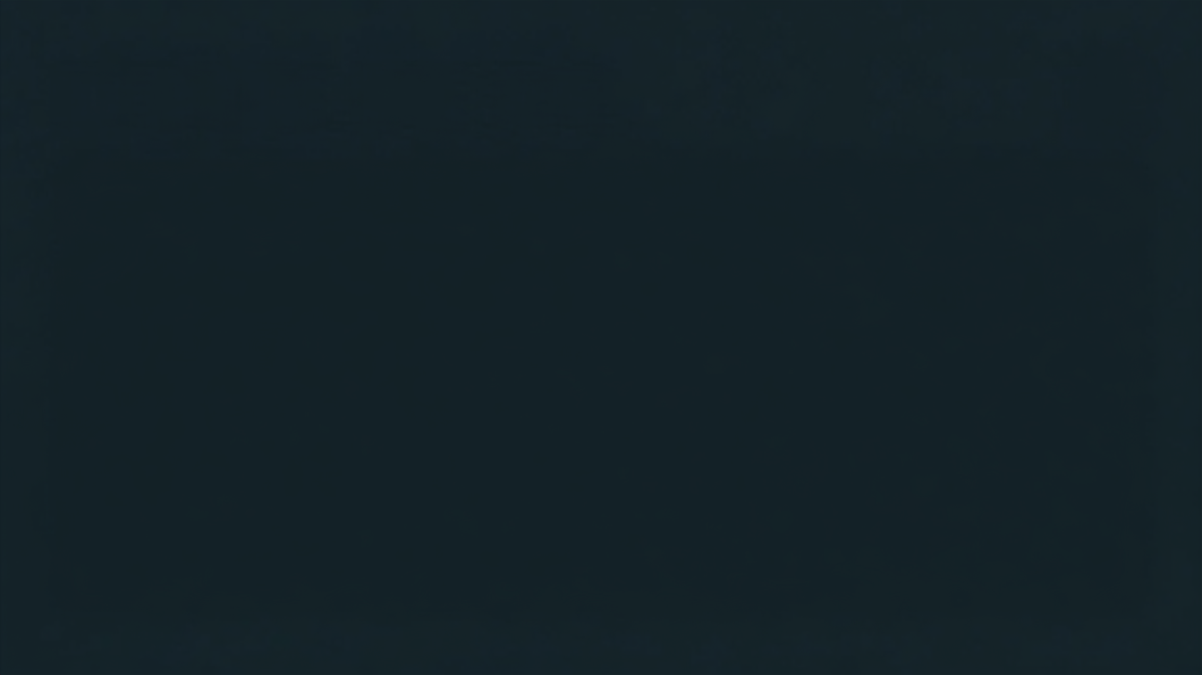


REWRITE ONE ASK.
We’re inviting [participant] to [action] by [date].
The commitment is [time/resources].
We’ll provide [support].
Your contribution will help [intended outcome].
We’ll follow up with [result or update].

Slide 11


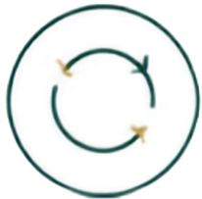




FROM AWARENESS TO ACTION
12 / FOLLOW UP
Track what people do next.
Commit
Complete
Return
Invite others
Tell members what their contribution made possible.

Slide 12
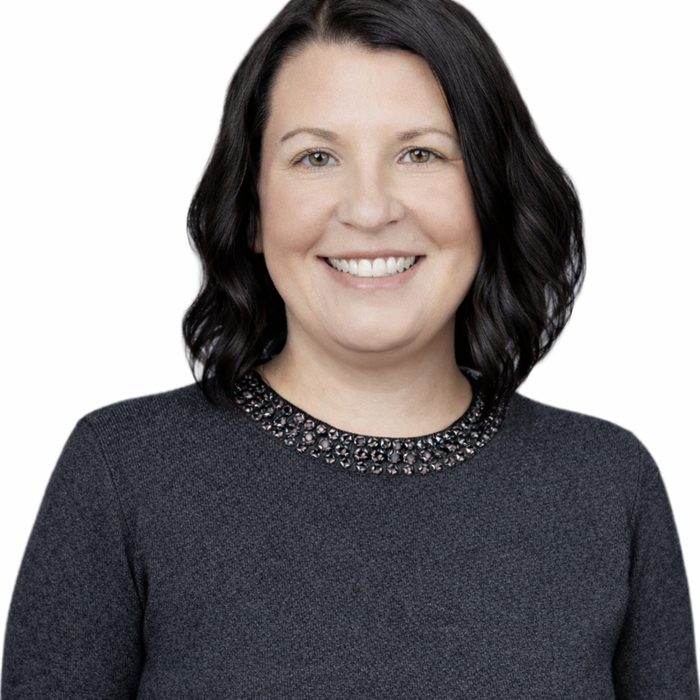
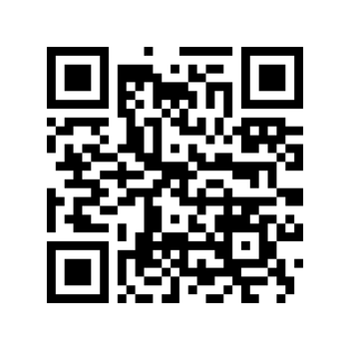

FROM AWARENESS TO ACTION
12 / ABOUT
let’s keep
building connections
Educator. Operator. Strategist. Connector.
I build bridges between people, systems, and opportunity—
then help others cross them.
Have an idea we should explore together?
Let’s connect.
thecoryblaylock@gmail.com

